Slide 1
Innovation Adoption in US Hospitals [playing nicely with big, secondary data]
Tobin Turner, PhD
Presbyterian College

Slide 2
Research & Talk Focus
Innovation Diffusion (from a management perspective)
Big Data*
Data challenge: HCUP NEDS Data (hospitals and patients anonymous across years)
FOCUS
RELATED
HOSP Strategic Group

Slide 3
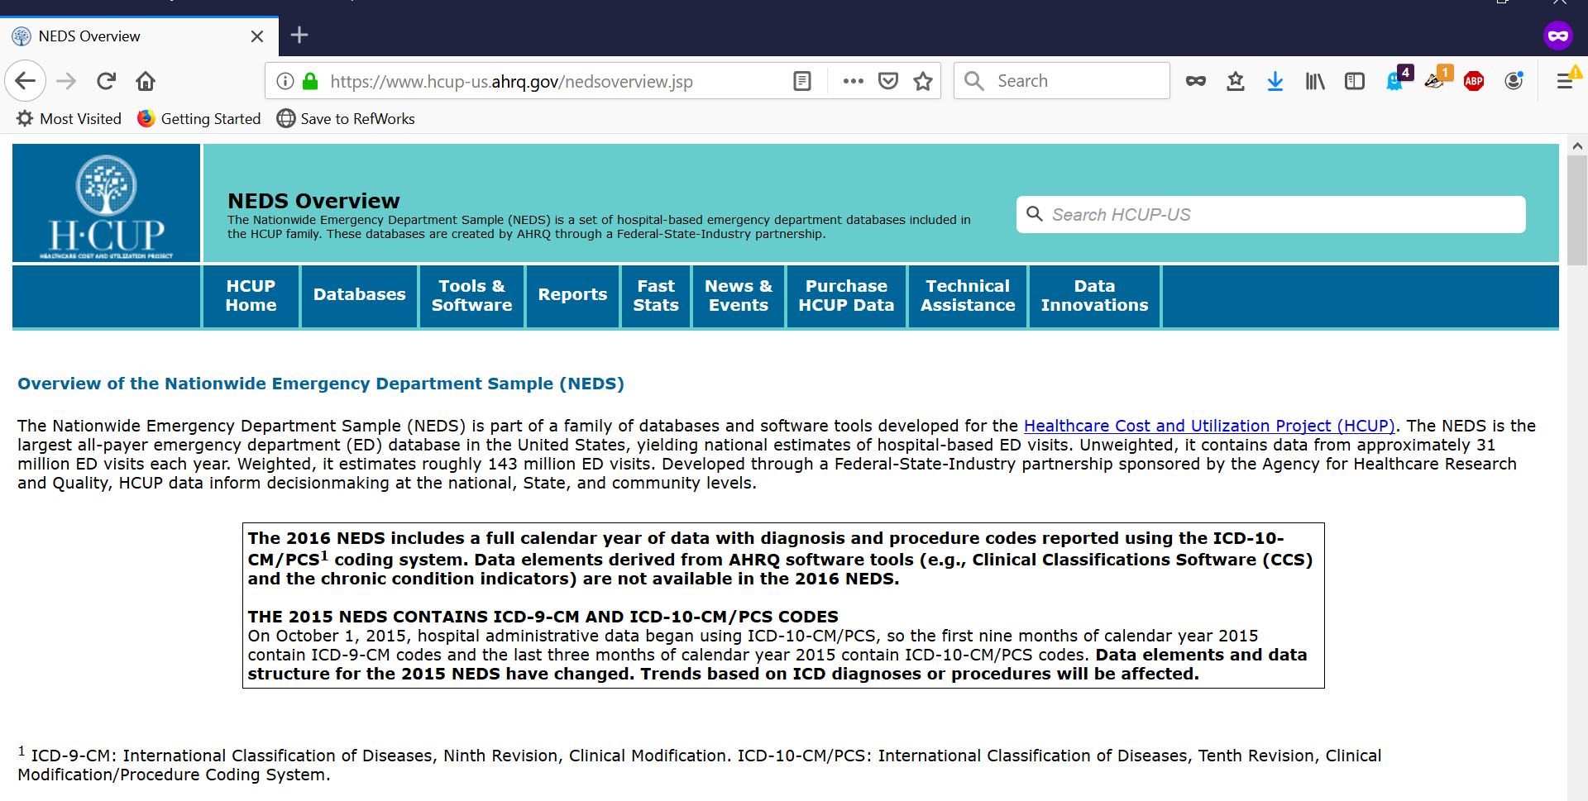

Slide 4
Research Questions…
Intra-strategic group vs. inter-strategic group influence?
New service/procedure vs. organizational routines?
 |  | Strategic Group Referents
 |  | Intra-Group Type | Inter-Group Type
Organizational Strategic Action | New Routine / Practice | Slower adoption, but faster imitation | Slow adoption & imitation
 | New Service Offering | Fast adoption & imitation | Fast adoption, but slower imitation

Slide 5
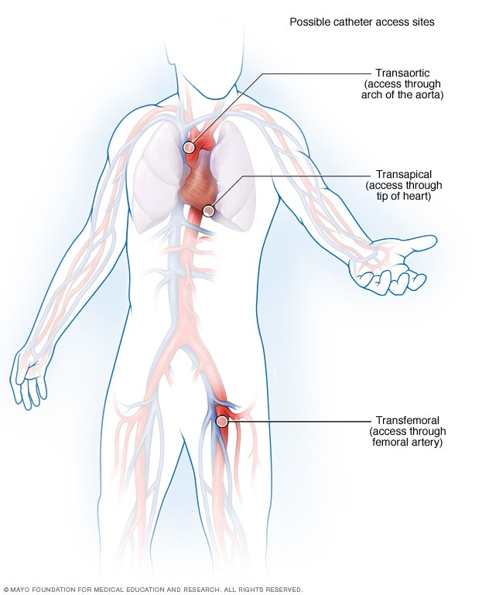

TAVR (transcatheter aortic valve replacement) Approved 2011 for High-Risk Patients

Slide 6
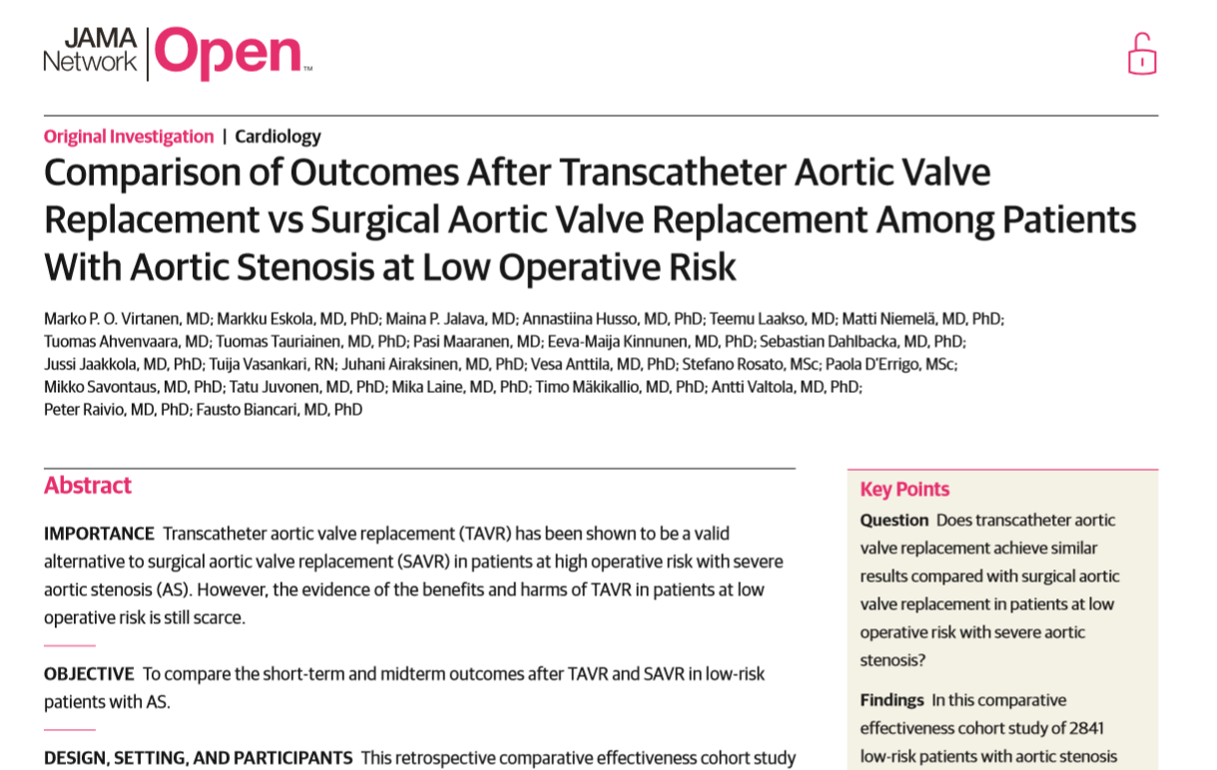
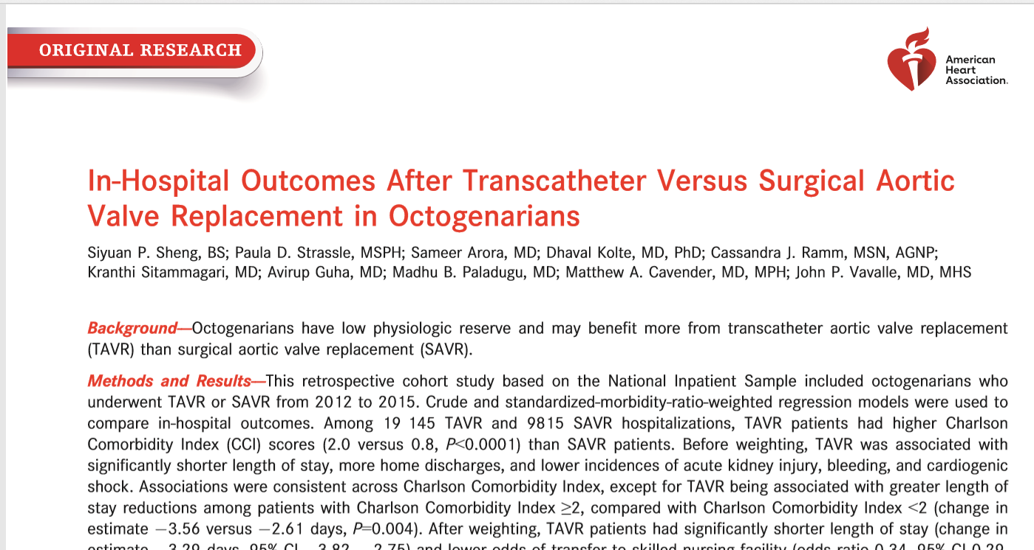

Slide 7
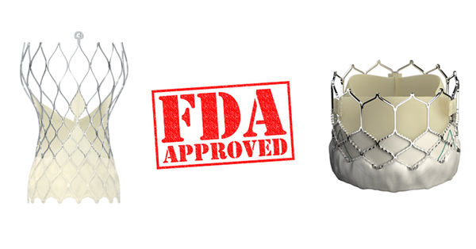
August 16, 2019 — In one coordinated move, the U.S. Food and Drug Administration (FDA) opened use of TAVR to low-risk patients today… and includes patients who may be younger and more active than higher-risk patients.

Slide 8
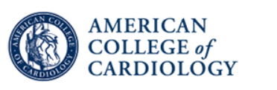
Operator and Institutional Requirements for TAVR
Training for TAVR should occur by one of two pathways:
1) a formal training program incorporated into cardiology fellowship or cardiovascular surgical residency, or
2) formal proctorship wherein an established interventional cardiologist or cardiac surgeon participates in an established TAVR program under the tutelage of an experienced team.

Slide 9
HOSP
955
966
980
964
961
951
950
947 945
SAVR
1,940 2,070 2,214 2,177 2,209 2,159 2,134 2,360 2,423
Data Flow
FOCUS
RELATED
HOSP Strategic Group
ED Visits
2006 25,702,597
2007 26,627,923
2008 28,447,148
2009 28,861,047
2010 28,584,301
2011 29,421,411
2012 31,091,020
2013 29,581,718
2014 31,026,417
Admitted
3,970,365
4,151,184
4,433,719
4,395,210
4,391,636
4,307,389
4,473,479
4,237,422
4,388,925
TAVR
0
0
0
0
0
11
117
129
279

Slide 10
Focus (FOCUS_{jt}) : percentage of admitted patients at that hospital in a particular year whose primary diagnosis—the principal reason for hospitalization— falls in the area of cardiovascular disease.
> head(focus)
HOSP_ED ip.visits mdc5.visits perct
1 10002 4637 184 0.03968083
2 10008 5802 398 0.06859704
3 10011 11169 721 0.06455368
4 10015 15139 1519 0.10033688
5 10017 7019 281 0.04003419
6 10022 1848 115 0.06222944
Clark & Huckman (2012) Management Science

Slide 11
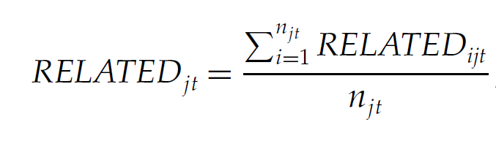
Related (RELATED_{jt}): the degree to which hospitals are engaged in related service categories as follows:
To calculate related services:
the presence of these secondary conditions suggests the need for knowledge and experience specific to treating
aggregate these secondary diagnoses into service groups using major diagnostic categories (MDCs).
Each MDC corresponds to a single organ system or disease category.
MDC 10 Endocrine, nutritional, and metabolic diseases and disorders 64%
MDC 4 Diseases and disorders of the respiratory system 31%
MDC 6 Diseases and disorders of the digestive system 21%
Clark & Huckman (2012) Management Science

Slide 12
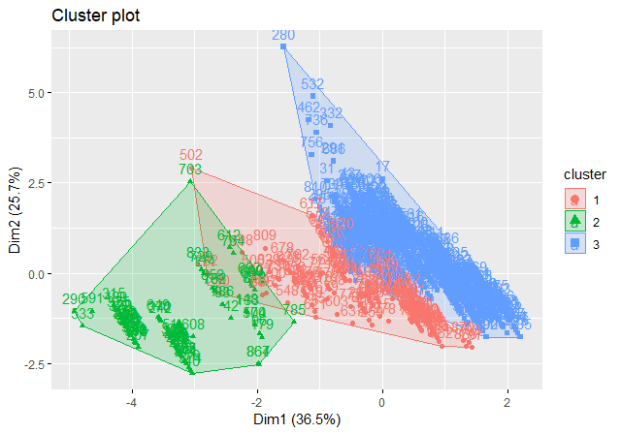
library(cluster) # clustering algorithms library(factoextra) # clustering algorithms & visualization library(gridExtra) # multiple plot formatting
> pr.out$rotation
PC1 PC2 PC3 PC4
perct.mdc5.visits -0.22132801 -0.66186730 0.69783467 -0.161159437
TOTAL_EDVISITS 0.09675998 0.70562434 0.70189761 0.008458201
HOSP_TRAUMA 0.70066213 -0.07494624 -0.01269649 -0.709432482
HOSP_URCAT4 0.67135982 -0.24167960 0.14214540 0.686047847

Slide 13
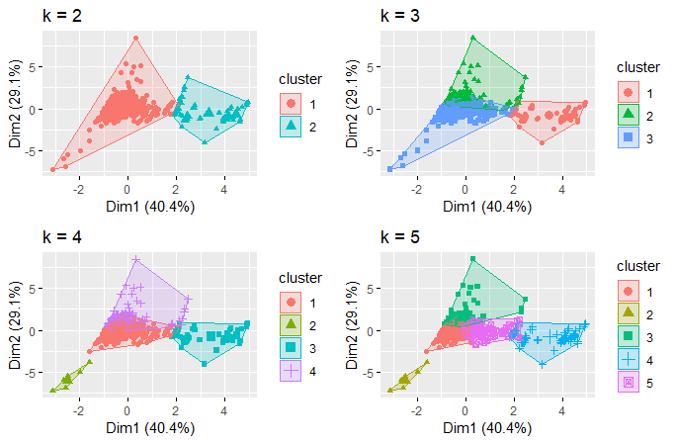

Slide 14
Research & Talk Wrap-Up
Procedures or Diagnosis that have clean ICD-9/10 entries?
Big Data* (AWS S3 & EC2)?
Interesting ways to leverage big, nasty secondary data?

